Slide 1
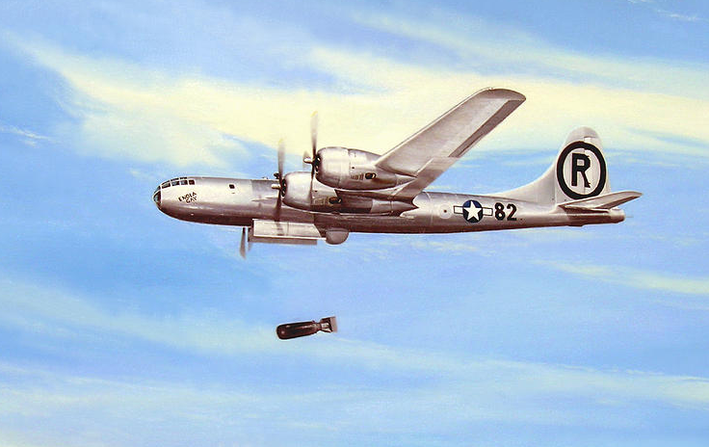
WORLD WAR II: USA vs. JAPAN (1941-1945)

Slide 2
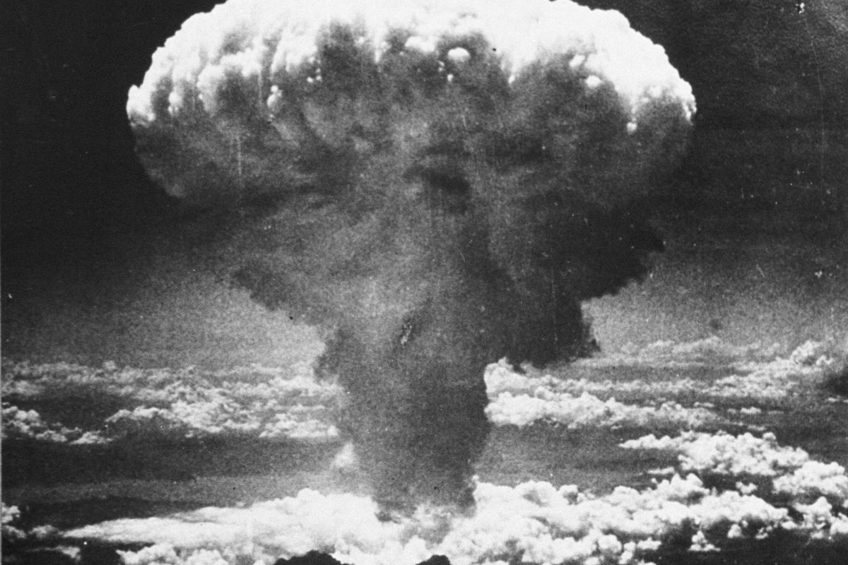
HIROSHIMA & NAGASAKI (1945)

Slide 3
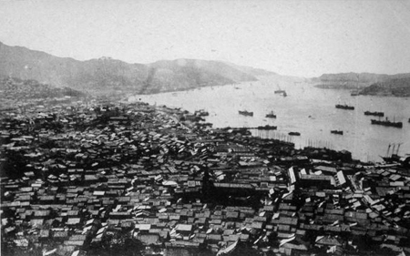
HIROSHIMA & NAGASAKI (1945)

Slide 4
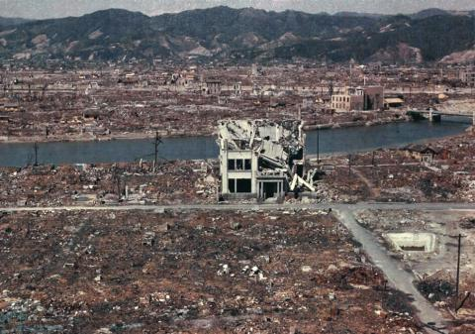
HIROSHIMA & NAGASAKI (1945)

Slide 5
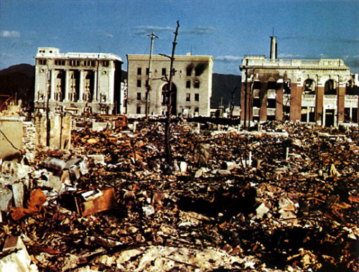
HIROSHIMA & NAGASAKI (1945)

Slide 6
FOREIGN vs DOMESTIC POLICY
What effects did the atomic bomb have on the citizens of Hiroshima?
Why do you think the United States decided to drop the atomic bomb?
What other options/alternatives do you think should have been considered?
When is such military force necessary?

Slide 7
FOREIGN vs DOMESTIC POLICY
Domestic policy is what happens INSIDE a country.
EX: taxes; police; elections; health care; business
Foreign policy is what happens OUTSIDE a country’s borders. It’s kind of like a blueprint for how a country treats other nations.
EX: foreign aid; treaties; wars; trade

Slide 8
5 GOALS OF FOREIGN POLICY
Maintaining national security
Supporting democracy
Promoting world peace
Providing aid to people in need
Establishing open trade

Slide 9
BELL RINGER
CLASSWORK
Read p. 584-589
As you read, work on answering the given questions.
Lesson Close:
Think back to the 5 main goals of foreign policy. Pick one. What might be something that the United States could do to help meet this goal? Pretend that you are a reporter for a newspaper or TV station, and construct a brief news story reporting on the U.S. doing something to meet this goal. Be specific with details! (You may make them up.)

